Slide 1
Personal Email Financial Analysis
Data Science Study Case
Angel Berta Desi Suryanti Puji Resmiati

Slide 2




The problem

Slide 3
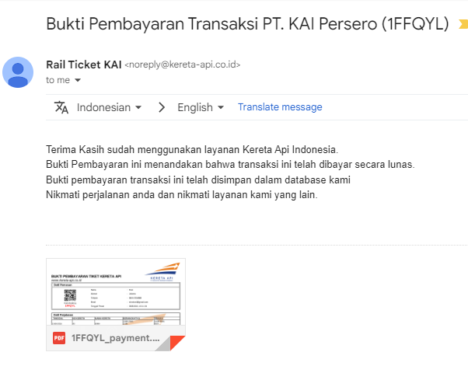
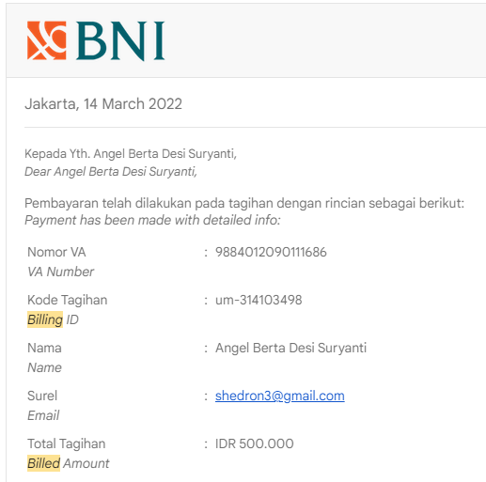
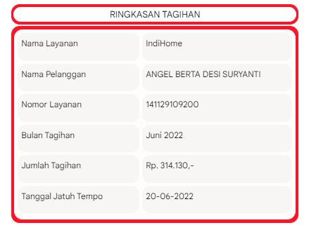
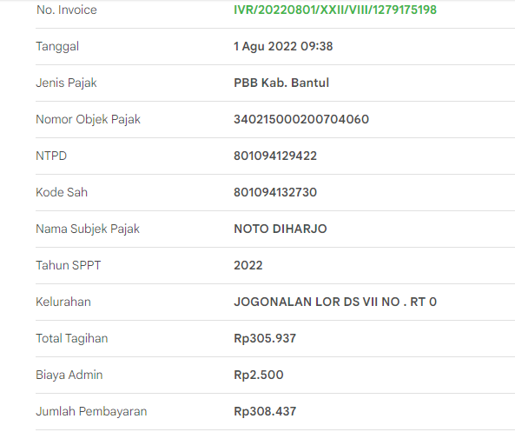
The problem

Slide 4
The problem
Problem statement
There are unorganized email in our GMAIL inbox
Those emails are uncategorized and coming from so many application (e-commerce, entertainment, bank, membership account)
It is hard to analyse the email related to billing and other expenses email

Slide 5
Challenges deep-dive
Challenge 1
Challenge 2
Challenge 3
Data Collection
Found non standard email will give homework to the project
Data Extraction
Body email extraction needs extra care code to process it, and it’s not easy to do it
Data format
Cleansing the data to the standard format is one of thing to do

Slide 6
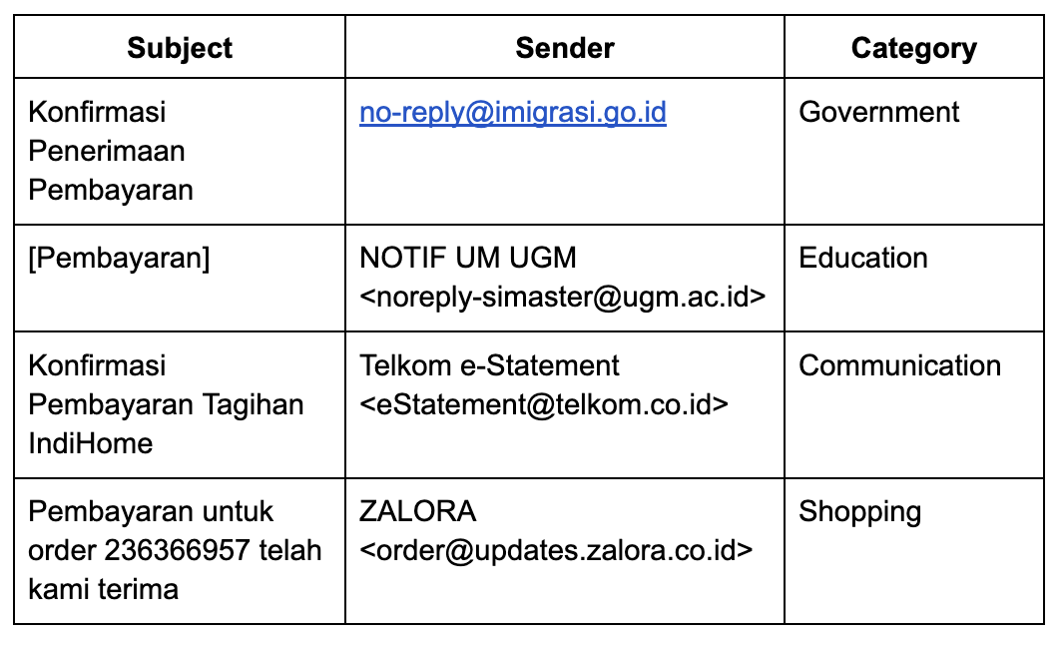
Analysis
Qualitative Analysis

Slide 7
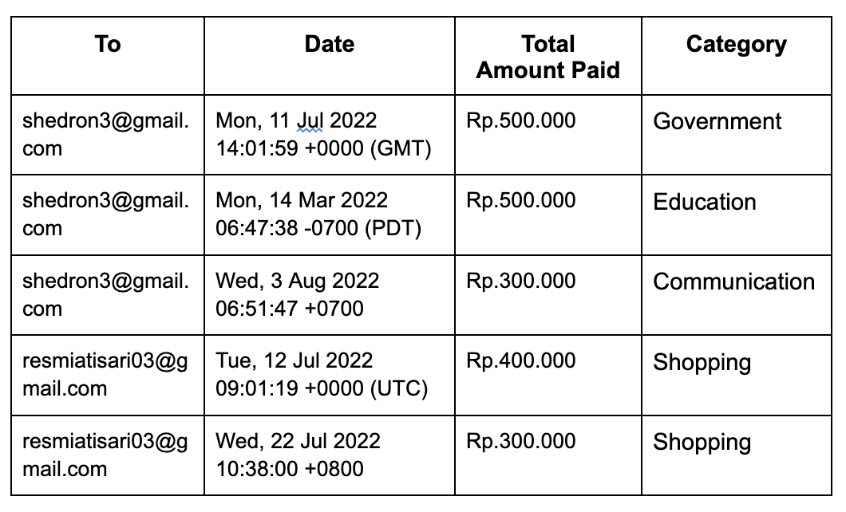
Analysis
Quantitative Analysis

Slide 8
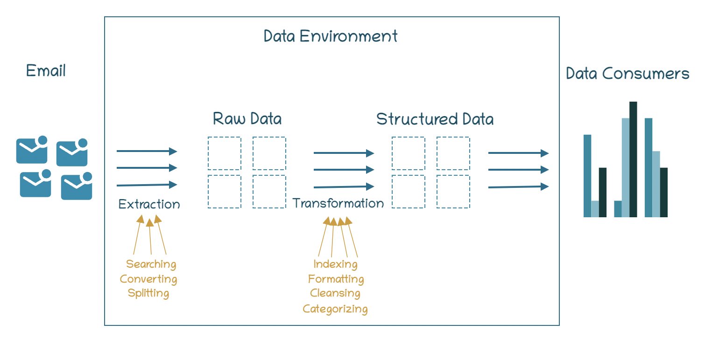
System Design:
Python
Gmail API
BeautifulSoup
Report Design:
Graph
Database Design: Mysql

Slide 9
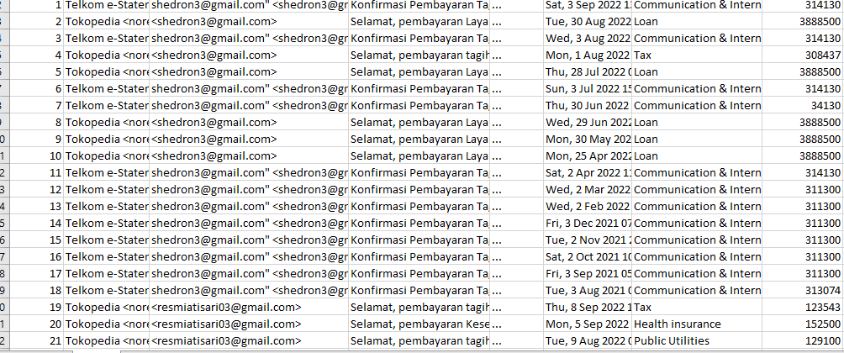
Current Result Design

Slide 10
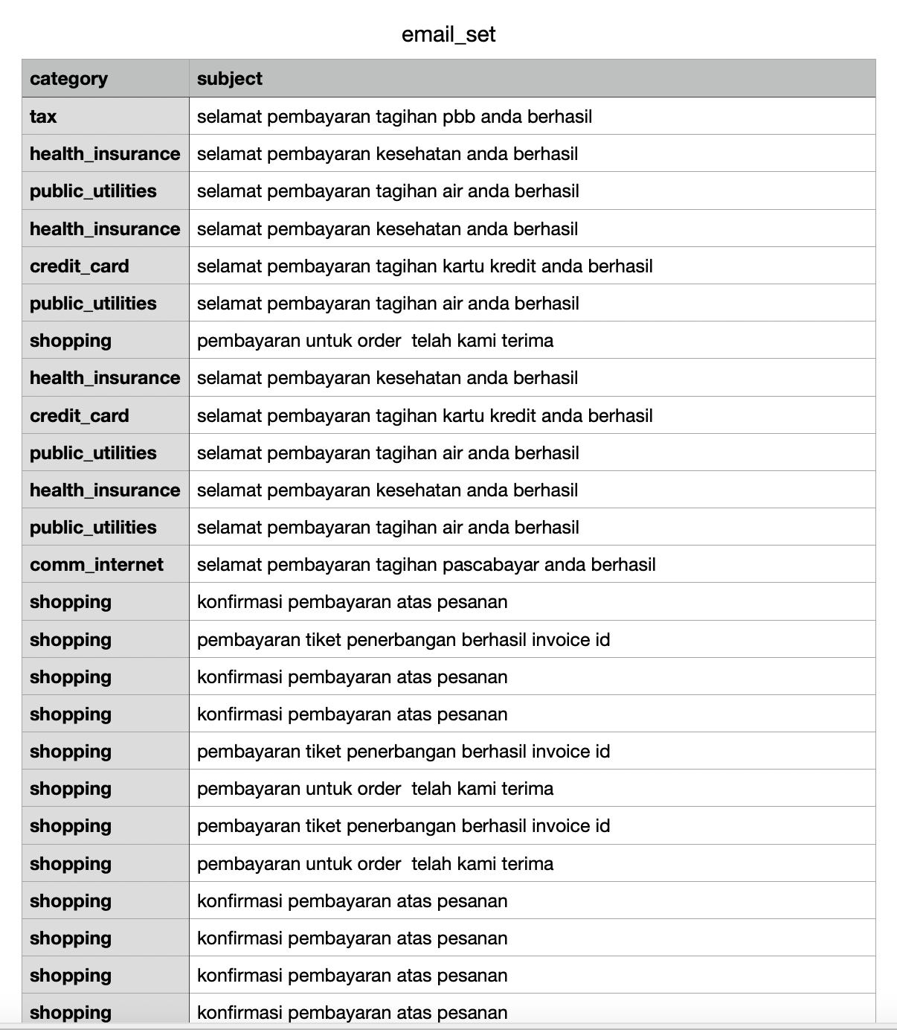
Implementation
Data Extraction
Tax : 2 number of rows
Health_insurance : 5 number of rows
Public_utilities : 4 number of rows
Credit_card : 3 number of rows
Shopping : 112 number of rows
Comm_internet : 26 number of rows
Loan : 37 number of rows

Slide 11
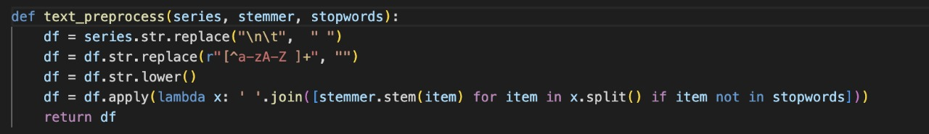
Implementation
Data Pre-process
Pre-processing using Sastrawi Library

Slide 12
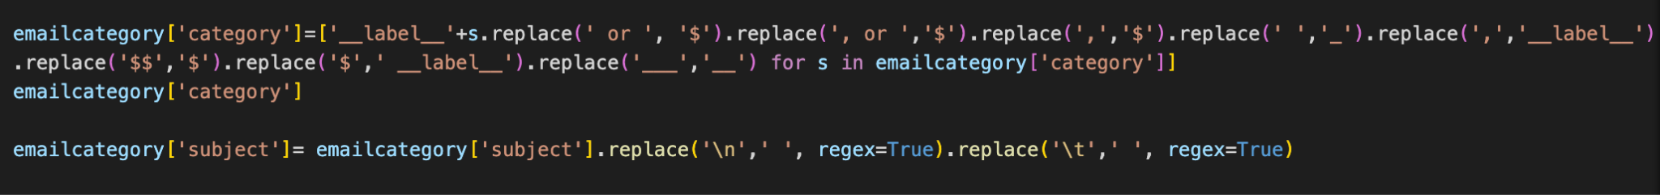
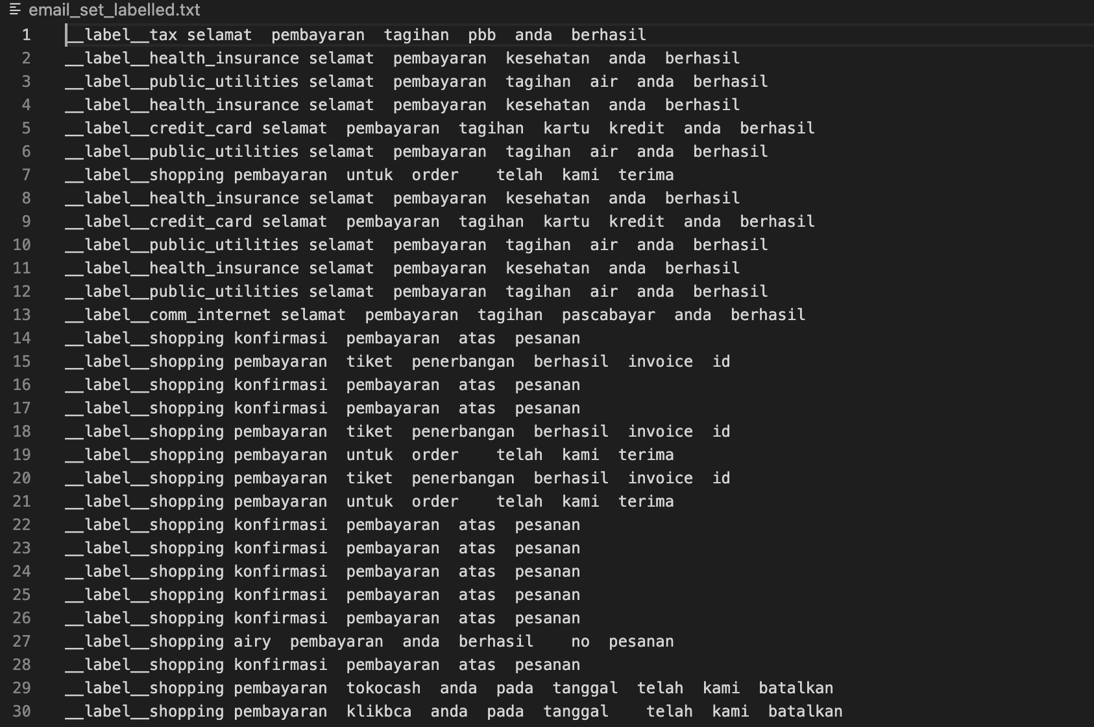
Implementation
Data Pre-process
Manually labeled email set
Labeled email set

Slide 13
Implementation
Data Training and Set
Train by supervised learning using fastText. Using epoch =25, only able to distinguish 2 classifications
Label of Category = ['__label__comm_internet', '__label__shopping']
Sum of Transaction = [Decimal('308437'), Decimal('26679862')]
Performance:
Label shopping: 99% precision
Label comm_internet: 3.8% precision

Slide 14
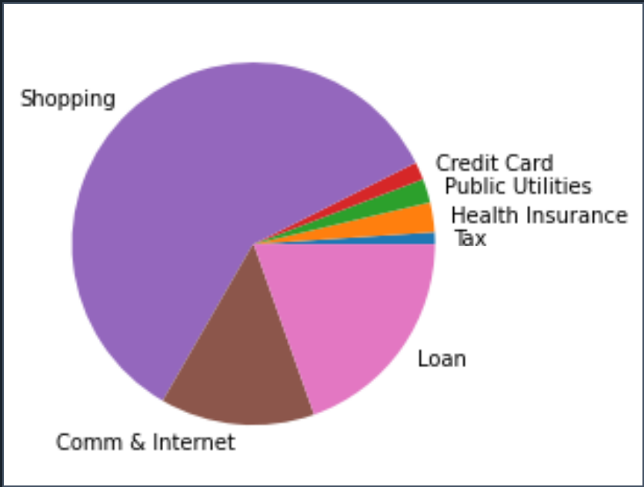
Implementation
Data Training and Set
Train by manual labeling into the data set
Label of Category = ['Clothing&Beauty', 'Tax', 'Public Utilities', 'Health insurance', 'Shopping', 'Communication & Internet', 'Loan']
Sum of Transaction = [Decimal('303760'), Decimal('431980'), Decimal('696000'), Decimal('762500'), Decimal('1089265'), Decimal('7382426'), Decimal('36263334')]

Slide 15
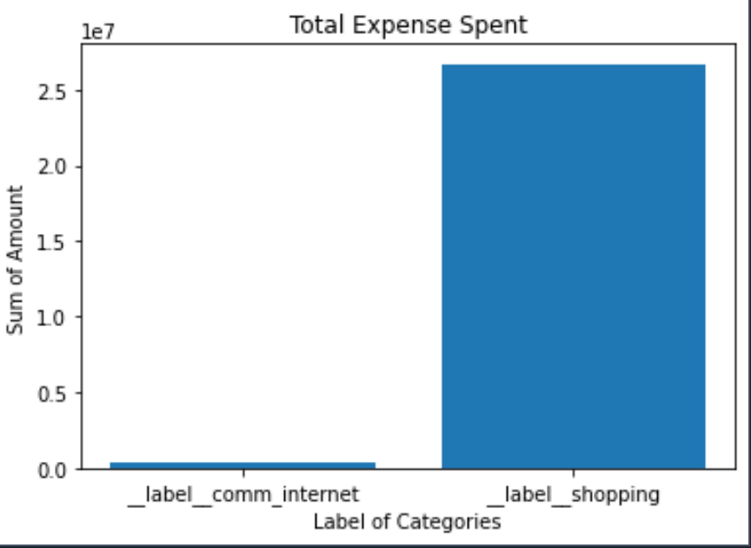
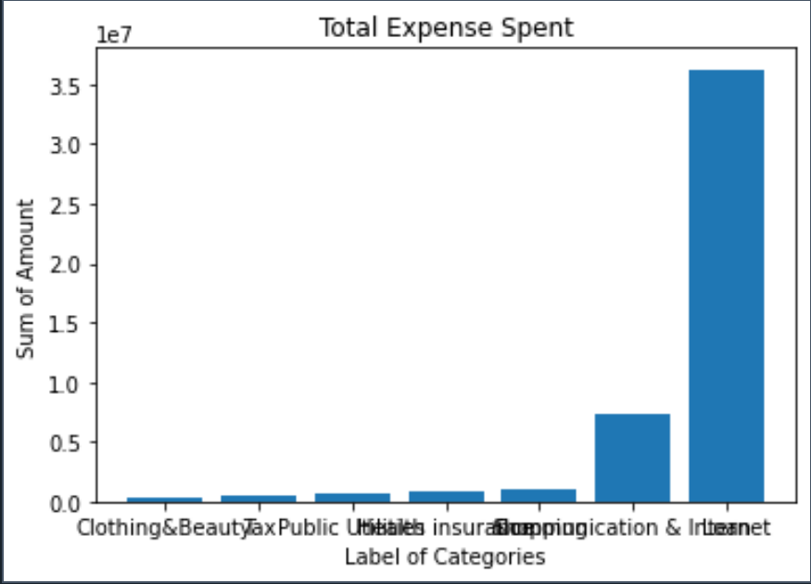
Implementation
Data Transformation
Train by supervised learning using fastText.
Train by manual labeling into the data set

